Slide 1
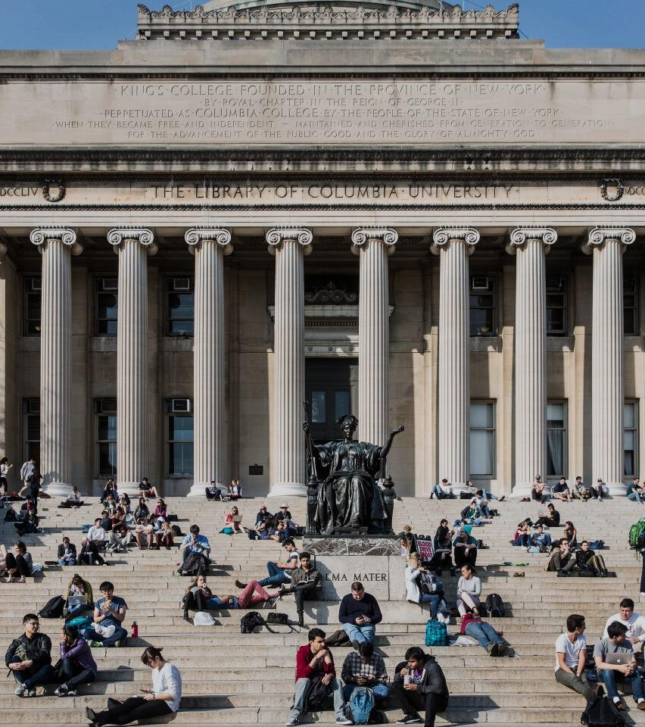
The Blueprint
PROBLEM STATEMENT
Columbia has historically deprioritized student wellness and community-building, as these factors are not directly measured in the university’s performance metrics. Community and wellness drive student success and alumni engagement.
As a result, there are no coordinated efforts to strengthen campus community or improve student wellness. For example, current spaces on campus either lack availability, short on adequate amenities, or do not foster a sense of comfort, safety and belonging.
We need a way to build campus community and improve student wellbeing such that Columbia Engineering is first among peers for community and wellness.
01

Slide 2
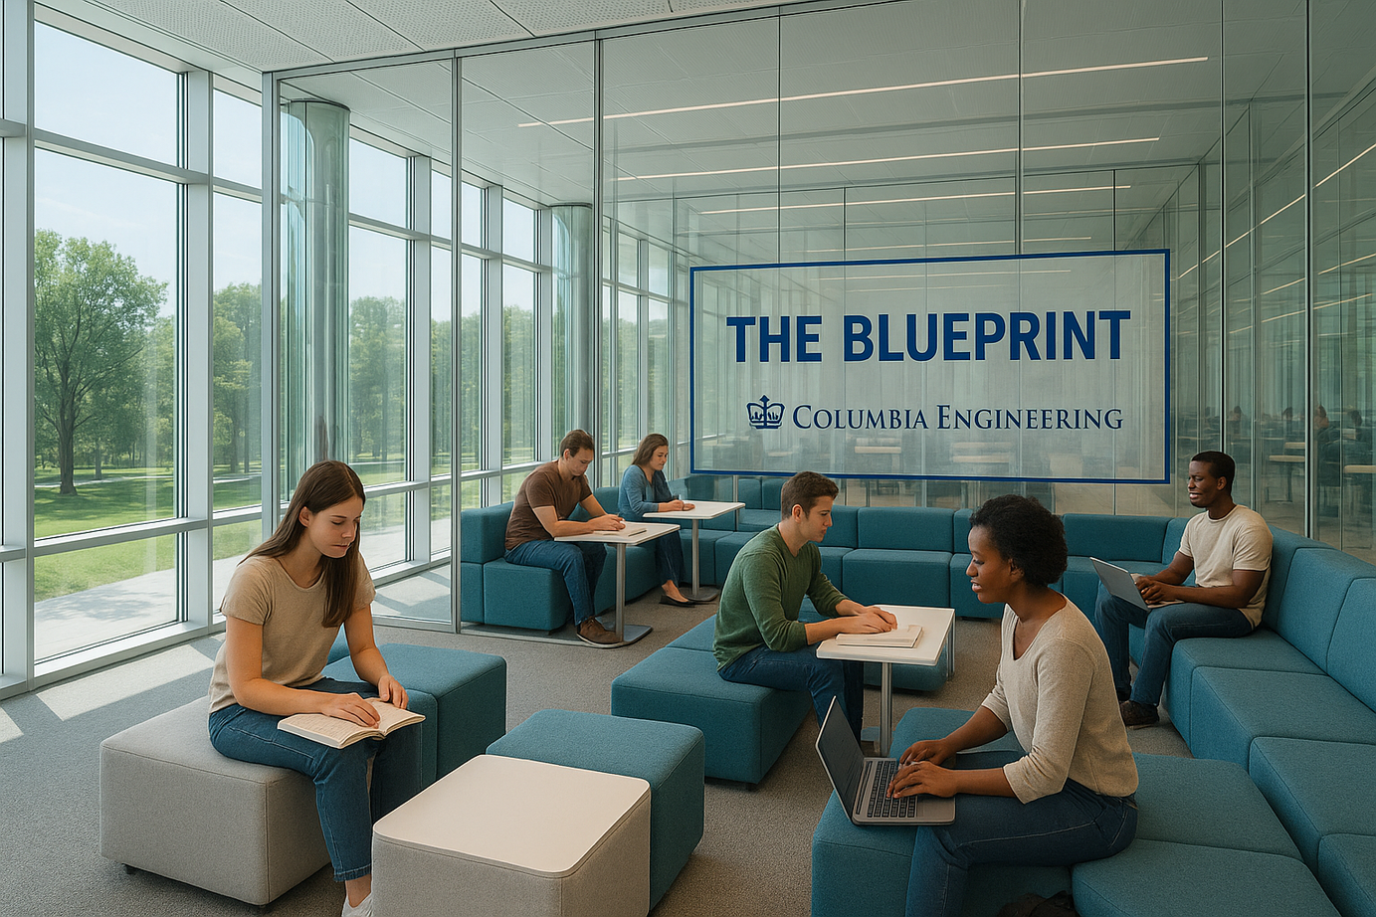
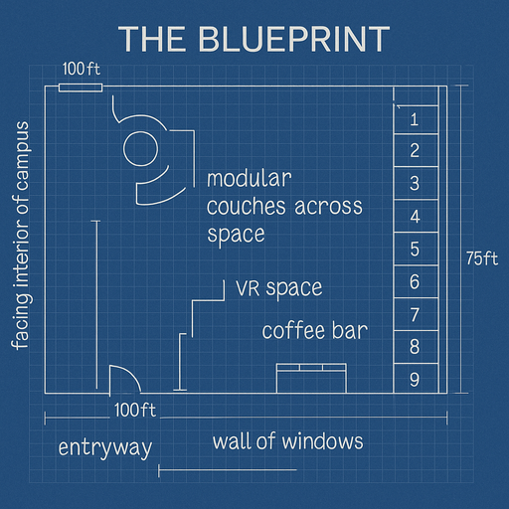
The Blueprint
PITCH
Students need places to connect, and belong. Yet traditional campus buildings often separate wellness from learning, missing the opportunity to support the whole student.
We’ve seen that when students feel real ownership like at Howard’s CLDC, those spaces become cultural anchors. They turn into places where ideas grow, networks deepen, and alumni return to stay connected.
This is a student-owned sanctuary designed for collaboration and long-term community. It’s a space that supports the mind and sustains the relationships that carry students beyond graduation. The message is simple: this is your space, where you belong, both now and for the future.
03

Slide 3
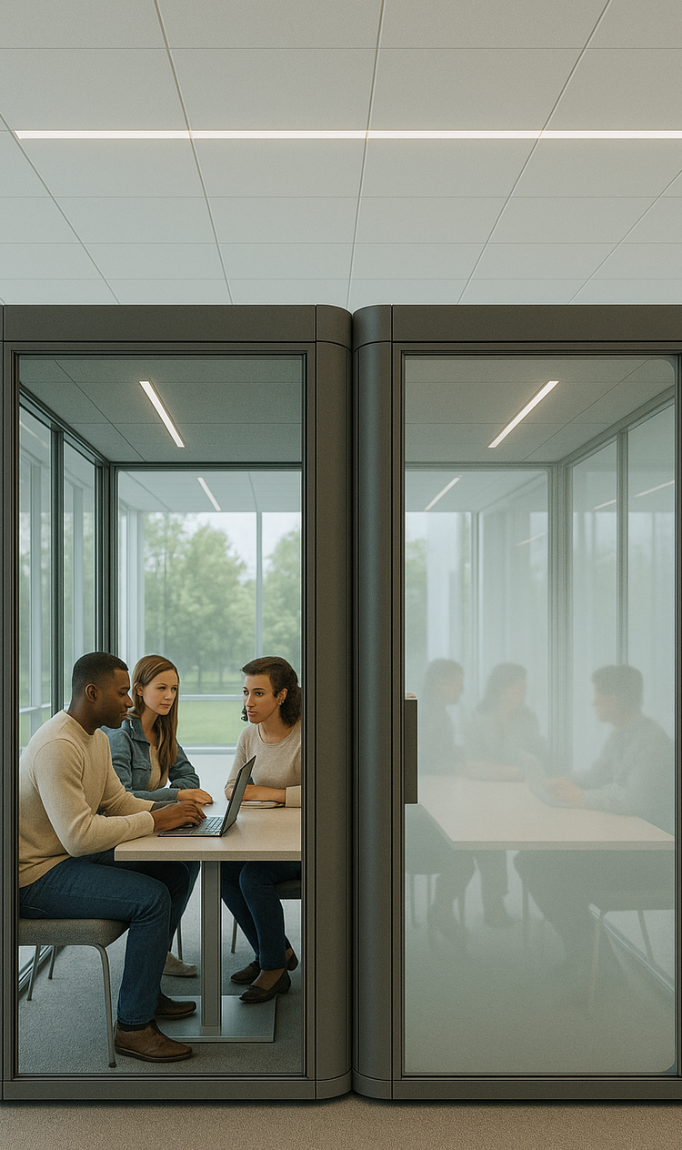
OUR VISION
The Blueprint
The Blueprint is a 28,500 sq ft student-owned collaboration floor at Columbia Engineering designed to foster community and support wellness. It's an active space: Students control scheduling, activities, and decor, making it an accomodating space for the evolving community and environment.
Key features include:
Open collaboration zones with modular furniture and VR spaces
A coffee bar and casual seating for informal meetups
Private group pods for focused work
An outdoor terrace facing the campus interior
Interactive art and adaptable decor curated by students
PDLC smart windows for meeting pods
Programming includes:
Yoga nights, phone-free hours, and themed quiet blocks
Club presentations, guest speakers, and social events
Coworking & Access
Students and staff have automatic access. Alumni are encouraged to co-work, host sessions, and casually engage with students; blurring the lines between generations. The space helps alumni shift from occasional visitors to active participants, deepening mentorship, building networks, and fostering a lasting sense of community across time.
03
MEETING PODS

Slide 4
The Blueprint
PITCH
03

